Slide 1
Succinct Data Structures
Reporter: Chiou-Ting Tseng
Date: Sept. 14, 2006

Slide 2
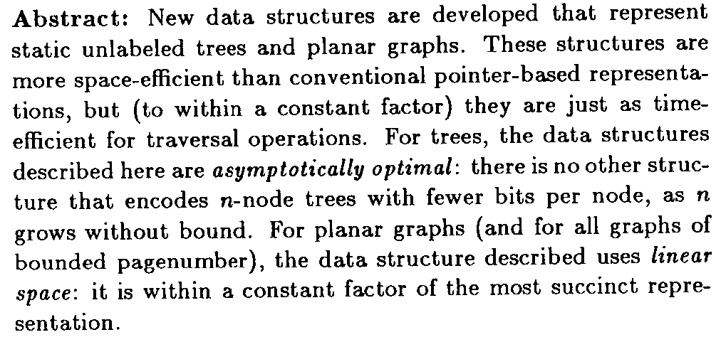
Abstract

Slide 3
Reference
D. K. Kim, J. C. Na, J. E. Kim and K. Park, “Efficient Implementation of Rank and Select Functions for Succinct Representation,＂ Workshop on Experimental and Efficient Algorithms 2005, pp. 315-327.
G. Jacobson, “Space Efficient Static Trees and Graphs,＂ In Proceedings of the 30th Annual IEEE Symposium on Foundations of Computer Science, pp. 549-554, 1989.
数据结构压缩的若干试验结果,陈研, 福州大学, 2006
D. R. Clark, “Compact Pat Trees,＂ PhD thesis, University of Waterloo, Waterloo, 1988.
G. Jacobson, “Succinct Static Data Structures,＂ PhD thesis, Carnegie Mellon University, Pittsburgh, 1988.

Slide 4
Succinct Representation
Represent n objects by O(n) bits.

Slide 5
Introduction(1 of 2)
Traditionally, discrete objects are represented as integers which are the indices of elements in a consecutive memory block or values of logical addresses in main memory.
If we store n discrete objects in this way, they occupy O(n) words, i.e., O(n log n) bits.

Slide 6
Introduction(2 of 2)
There are C(2n, n)/(n+1) different binary trees with n nodes.
The bits required to distinguish the trees is 2n+o(n).
rep(T)= 0 rep(left-child of T) 1 rep(right child of T).

Slide 7
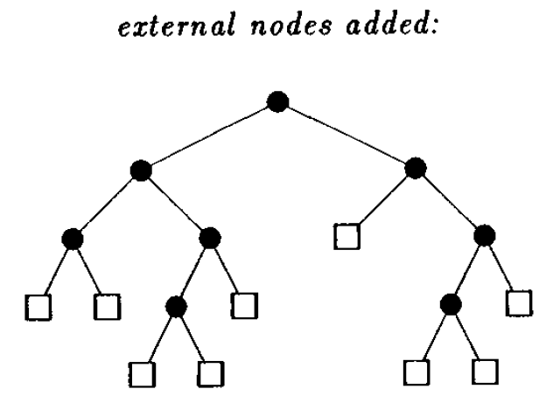
Succinct Binary Tree Representation(1)
0
1
0
1
0
1
0
1
0
1
0
1
0
0
1
1
0001100111010011

Slide 8
Drawback
It does not allow efficient tree traversal.
Finding right child requires worst case O(n) time.

Slide 9
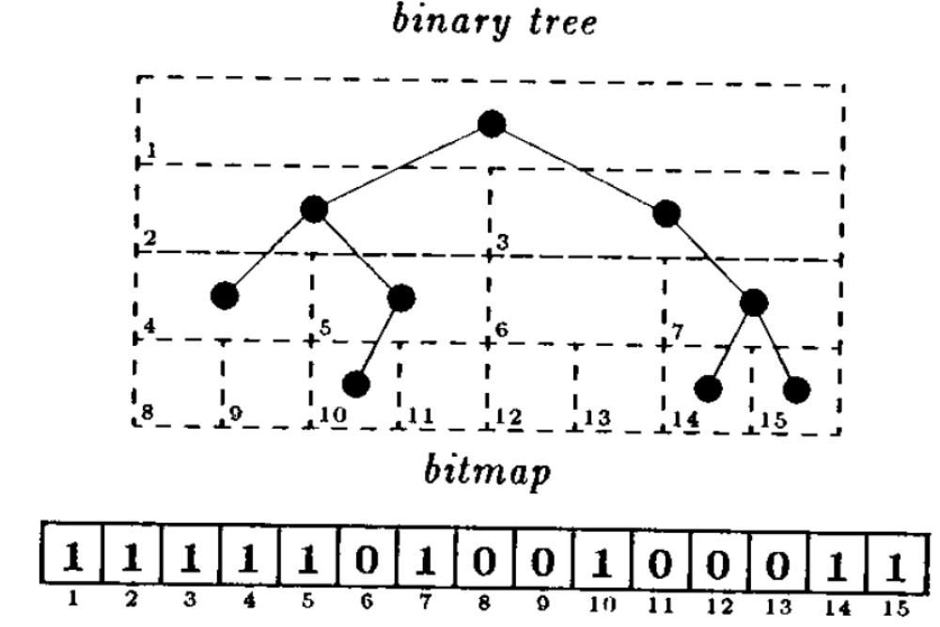
Heap Representation

Slide 10
Drawback
If the tree is unbalanced, the space will be extremely large.

Slide 11
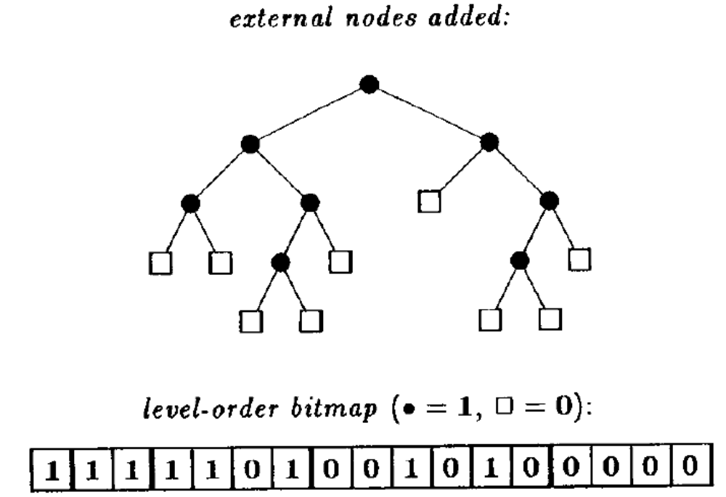
Succinct Binary Tree Representation(3)
a
b
c
f
g
d
e
i
j
k
m
h
l
a b c d e f g h i j k l m

Slide 12
Rank and Select
Given a static bit-string A,
rank_{A}(x) counts the number of 1’s up to and including the position x in A.
select_{A}(y): Finds the position of the y-th 1 bit in A.
A=10010110, rank_{A}(5)=2, select_{A}(2)=4

Slide 13
Tree Traversal
left-child(m)=2rank(m)
right-child(m)=2rank(m)+1
parent(m)=select(⎣m/2⎦)

Slide 14
Direct Thought
Record the position of all occurrence of 1.
At most n 1’s, each position in the range of [1, n]. So each position requires logn bits, totally nlogn bits.

Slide 15
History
G. Jacobson gave an n+Θ(nloglogn /logn) space, O(log n) query time algorithm.
D. R. Clark gave an n+o(n) space, constant query time algorithm.

Slide 16
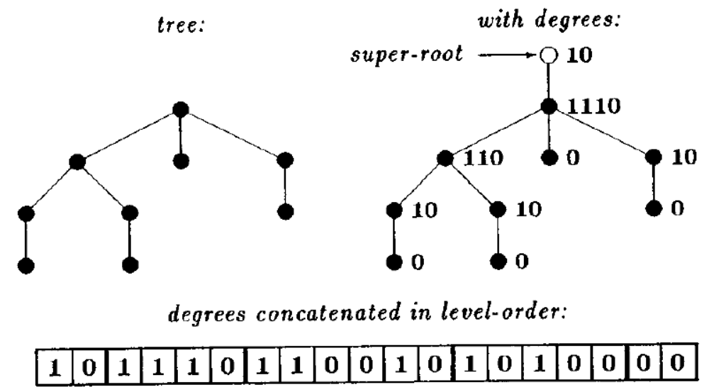
Rooted Ordered Tree

Slide 17
Tree Traversal
first-child(m)=select0(rank(m))+1
next-sibling(m)=m+1
parent(m)=select(rank0(m))

Slide 18
Clark’s Method(1)
Rank Directory
Partition A into big blocks of size log²n. Each big block of the 1st level directory records the accumulated number of 1’s from the first big block.
Partition A into small blocks of size logn. Each small block of the 2nd level directory records the accumulated number of 1’s from the first small block within each big block.

Slide 19
Clark’s Method(1)
rank-lookup-table: The table where an entry contains the number of 1’s in each possible bit pattern of length (log n)/c.
select-lookup-table: The table where an entry contains the position of the i-th 1 bit in each possible bit pattern of length (log n)/c, for 1 ≤ i ≤ log n/c.

Slide 20
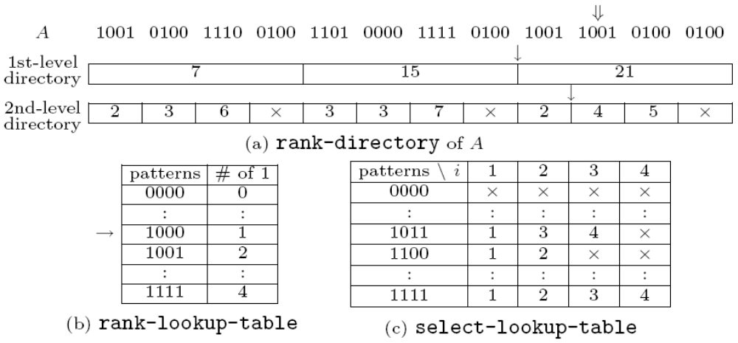
Succinct Data Structure

Slide 21
Space
rank-directory can be stored in o(n) bits.
1st: |block|=n/log²n, each logn bit
2nd: |block|=n/logn, each 2loglogn bit
Both rank-lookup-table and select-lookup-table can be stored in o(n) bits.

Slide 22
Rank
To get rankA(x), one first computes rankA(i) for an ending position i of the small block which includes A[x] using rank-directory, and then counts the number of 1’s in remaining x mod log n bits, which can be found by adding at most c entries in rank-lookup-table after masking out unwanted trailing bits.

Slide 23
Example of Rank
If we want to compute rank_{A}(38). We first get rank_{A}(36) = 17 using rank-directory. We get a bit-pattern 1000 by mask out A[37..40] = 1001 with 1100 and get the number of 1’s in 1000 using rank-lookup-table. So, we get rankA(38) = 18 by adding 1 to 17.

Slide 24
Select—1st level directory
The 1st-level directory records the position of every (log n log log n)’th 1 bit.
The 2nd-level directory consists of two kinds of tables. Let r be the size of a subrange between two adjacent values in the 1st-level directory and consider this range of size r.

Slide 25
Select—2nd level directory
If r ≥ (log n log log n)², then all answers of select in this range are recorded explicitly using log n bits for each entry.
Otherwise, one re-subdivides the range and records the position, relative to the start of the range, of every (log r log log n)’th 1 bit.

Slide 26
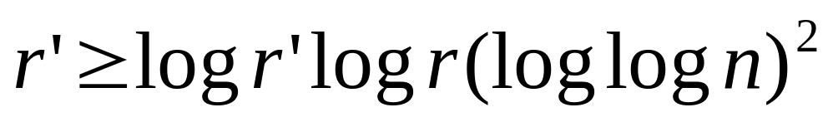
Select—3rd level directory
Let r’ be the size of a subrange between two adjacent values in the 2nd-level directory.
  If , then all answers are recorded explicitly.
  Otherwise, one records nothing. In this case, rank-lookup-table and select-lookup-table are used.

Slide 27
Select
To get select_{A}(y), one first finds the correct 1st-level directory entry, at position y/ log n log log n, and compute r. If r ≥ (log n log log n)², one can find the value of select_{A}(y) in the 2nd-level directory. Otherwise, a similar search is performed in the 2nd-level directory resulting in either finding the answer from the 3rd-level directory or scanning a small number of bits using lookup-tables. It was proven that the length of a bit-string scanned using lookup-tables is less than 16(log log n)⁴.

Slide 28
Example
Find the 15th 1
lognloglogn=4*2=8
1234 5678 9012 3456 7890 1234 5678 9012 3456 7890 1234 5678
1001 0110 1110 0100 1101 0000 1111 0100 1001 1001 0100 0100
1 2 34 567 8 90 1 2345 6 7 8 9 0 1 2
14 | 30
r=16 <8², logrloglogn=3*2=6
13
27-14=13

Slide 29
Drawback(1)
The retrieval time of Clark’s algorithm for select varies according to distribution of 0’s and 1’s in bit-strings. The performance gets worse as the number of 1’s in the bit-string becomes fewer. Especially when the number of 1’s in the bit-string is very few (the portion of 1’s is less than 10%), Clark’s algorithm becomes quite slow.

Slide 30
Drawback(2)
In Clark’s algorithm, there exists a worst case in which a large number of accesses to lookup-tables is needed. The reason is that 16(log log n)⁴ is much larger than log n in practice although the former is asymptotically smaller than the latter. For example, in case that the length of a bit-string is 232, the size of a block for accessing tables is 4096 and the number of table accesses is 256 in the worst case. The number 256 is too big to regard as a constant in practice.

Slide 31
Drawback(3)
The structure of directories is irregular because the subranges r and r‘ of entries vary. It makes it difficult to implement the algorithm using a bytebased implementation method.

Slide 32
End

Slide 33
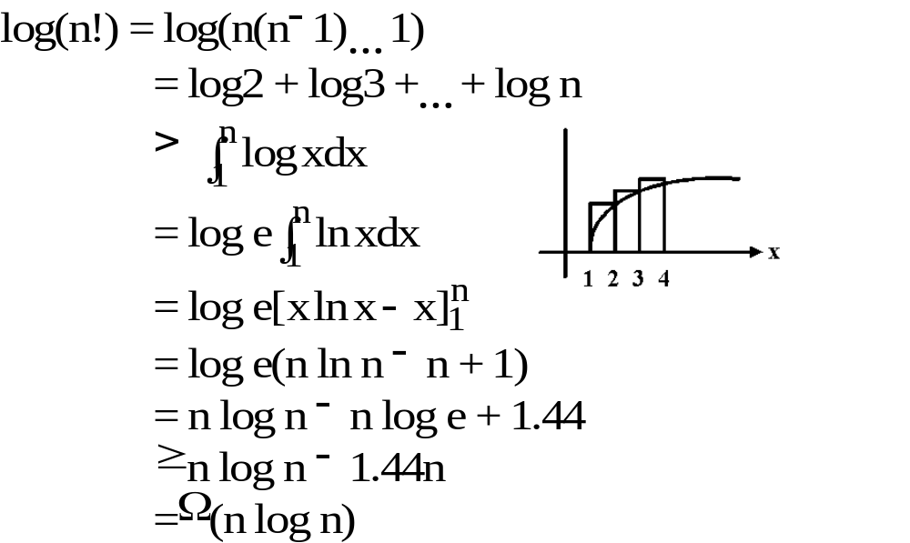
Method 1:

Slide 34
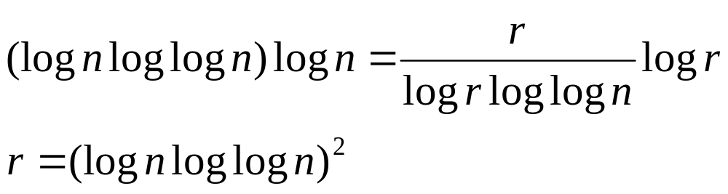

Slide 35
1st dir
k=lognloglogn
p₁
p₂
p₃
n
1
r₁
r₂
...
k-th 1
2k-th 1
3k-th 1

Slide 36
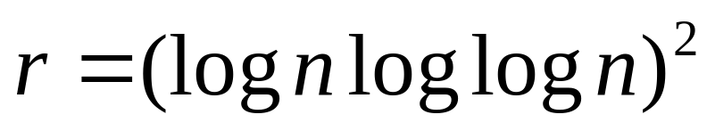
2nd dir
m=logrloglogn
p₁
p₂
p₃
r
1
r’₁
r’₂
...
m-th 1
2m-th 1
3m-th 1

Slide 37
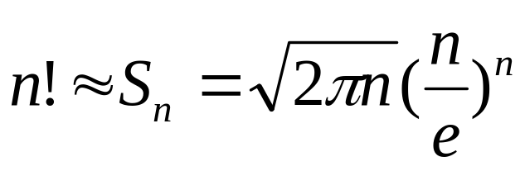
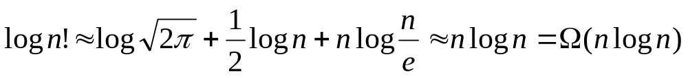
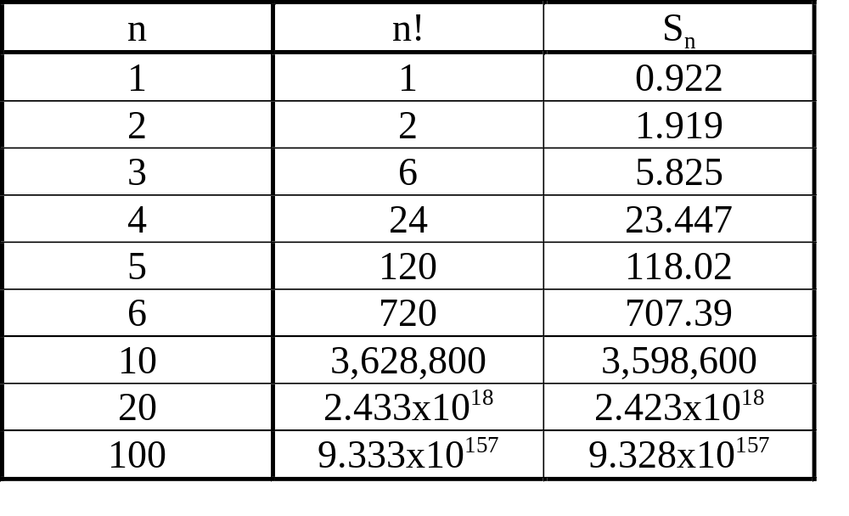
Method 2:
Stirling approximation:

